Slide 1
Completing StudySync Assignments
Aguirre
Notes:
Description: This is a title slide.

Slide 2
Setting Up & Accessing StudySync
Completing StudySync Assignments
Example StudySync Assignment Responses

Slide 3
Get Credit
-
Enable Google Integrations

Slide 4

Set up StudySync to Integrate with Google
If you have not already done so, please set up StudySync to integrate with Google by clicking on the link to the right.
Your grades will not import from StudySync to Google Classroom or Aeries without completing this step.
Notes:
Description: This is an announcement slide.

Slide 5
Although you will be accessing StudySync for materials, some of the work you complete will be through Google Classroom.

Slide 6
Walkthrough USING the First Day as an Example

Slide 7
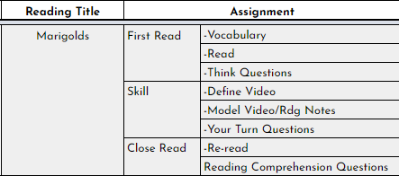
Example Outline of StudySync-Related Assignments
Notes:
Description: This is an announcement slide.

Slide 8
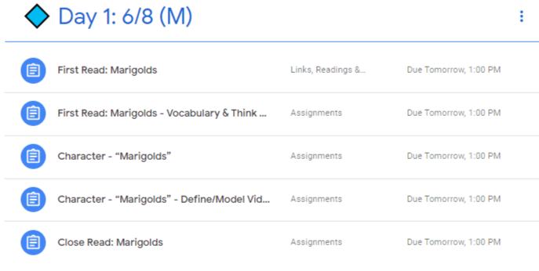
StudySync-Related Assignments As They Appear in Google Classroom
Notes:
Description: This is an announcement slide.

Slide 9


“Marigolds”: First Read: Vocabulary (20) & Think (50-200)
Read |  | Watch the video and read the material on StudySync.
Vocabulary |  | Complete the document entitled, “Vocabulary.”
Think Questions |  | Complete the document entitled, “Think Questions.”
Notes:
Description: This is an announcement slide.

Slide 10


“Marigolds”: Skill (Character) (20)
Define Video |  | Watch the video and read the material on StudySync.
Model Video/Rdg Notes |  | Complete the document entitled, “Define/Model Video & Reading Notes.”
Your Turn Questions |  | Complete the “Your Turn” section on StudySync.
Notes:
Description: This is an announcement slide.

Slide 11

“Marigolds”: Close Read (Reading Quiz) (100) & Write! (100-200)
Re-read |  | Watch the video and re-read the material on StudySync.
Reading Comprehension Questions |  | Complete the “Write” section on StudySync.
Notes:
Description: This is an announcement slide.

Slide 12
Notes
Complete all of the day’s assignments before the due date.
Make sure to complete work in the correct place (StudySync or Google Classroom).
For work completed in Google Classroom, make sure you have (1) completed all of the required documents; (2) attached all of the required documents; and (3) clicked “submit.”
Notes:
Description: This is an announcement slide.

